Slide 1
This is Daylight Savings.
Harvest more energy
from more places.
For Less.
Investor Presentation
March 2017

Slide 2
Forward Looking Statements
This presentation may contain forward-looking information about NanoFlex Power Corporation, a Florida corporation and its wholly-owned subsidiary, Global Photonic Energy Corporation, a Pennsylvania corporation (collectively, the “Company”). All statements other than statements of historical facts included herein regarding the Company’s financial position, business strategy, growth strategy and other plans and objectives for future operations, are forward-looking statements. The words “anticipate,” “believe,” “estimate,” “expect,” “intend,” “plan” and similar expressions that may tend to suggest a future event or outcome are not guarantees of performance and are inherently subject to numerous risks and uncertainties, many of which cannot be predicted or anticipated. Future events and actual results, financial or otherwise, could differ materially from those contained herein. Potential investors are cautioned that any such forward-looking statements are not guarantees of future performance and involve significant risks and uncertainties, and that actual results may differ materially from those projected in the forward-looking statements as a result of various factors, including without limitation, the risks set forth "Risk Factors" contained in the Company’s Annual Reports on Form10-K. Potential investors are urged to carefully consider all risk-factors highlighted in the private placement memorandum. All forward-looking statements are expressly qualified in their entirety by the foregoing cautionary statement.
This is not a solicitation to sell nor offer to buy.
Proprietary
2

Slide 3
Investment Highlights
Current solar technologies limit solar output and applications
NanoFlex-enabled solar solutions dramatically outperform currently commercialized thin films – enabling new applications & unlocking markets
Target priorities: military & portable power applications, high density solar farms and multi-story/space-constrained rooftops
Commercialization of NanoFlex technologies via joint development with manufacturing partner SolAero Technologies
Currently pursuing multiple sponsored development projects to accelerate commercialization & generate near-term revenue
Capital-efficient business model via fab-less manufacturing & licensing with industry partners accelerates commercialization & mitigates risk
Proprietary
3

Slide 4
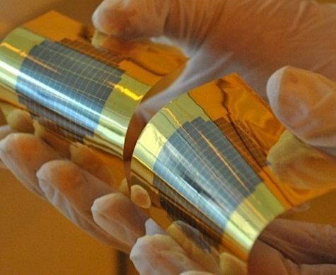
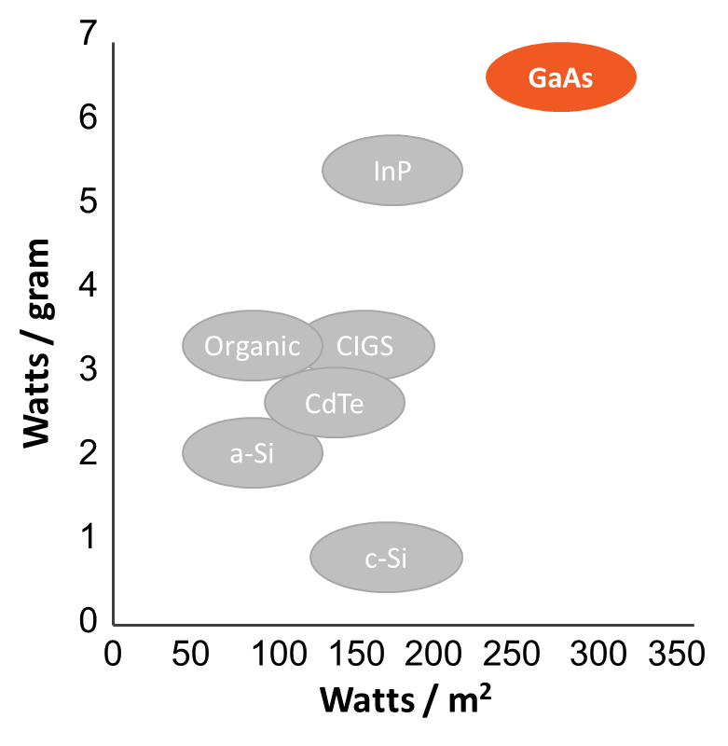
Opening New Markets to Solar Power
NanoFlex technology makes the highest efficiency
III-V space-program solar cells
cost-competitive, thin, and flexible
for terrestrial applications
Source: University of Michigan, NanoFlex Power
Proprietary
4

Slide 5
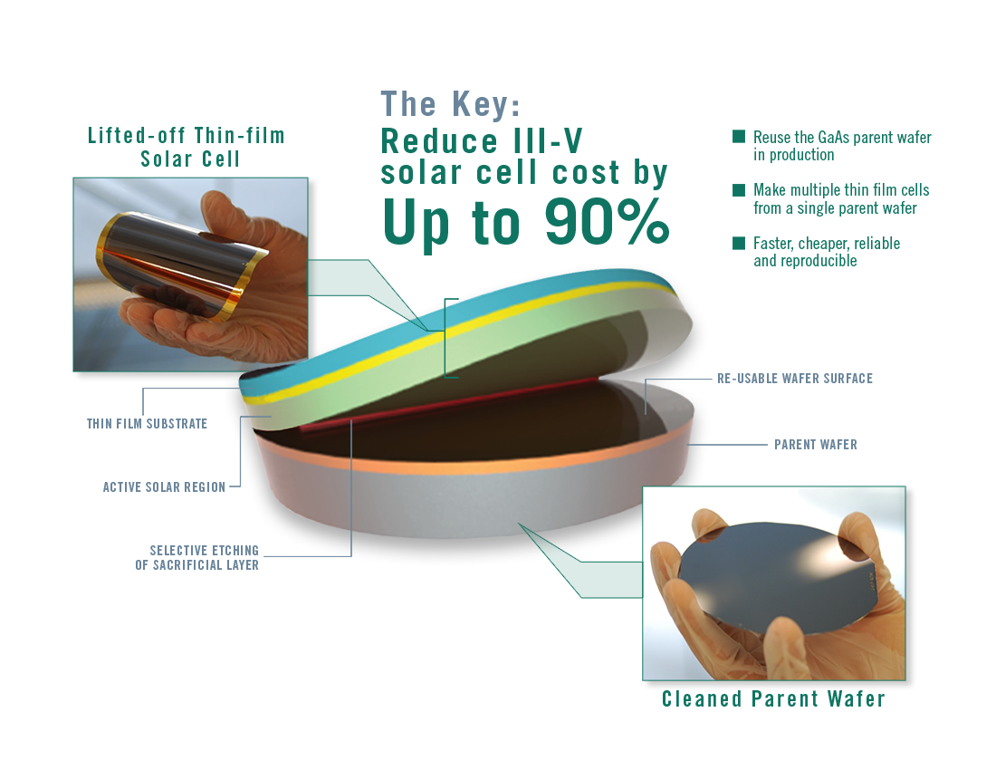
Patented Wafer Reuse Technology Creates
High Efficiency Solar Thin Films at Breakthrough Prices
Made possible through patented Non-Destructive Epitaxial Lift Off
Proprietary
5

Slide 6
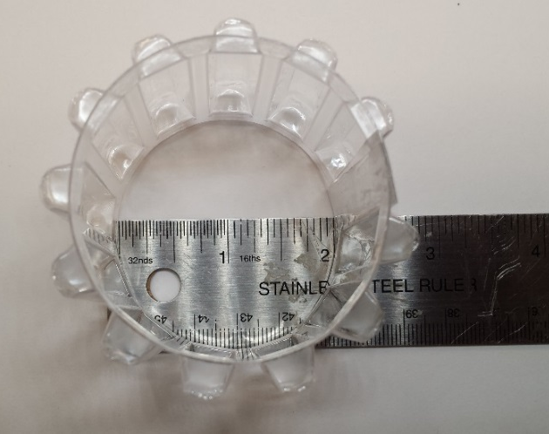
More Savings: Mini-Concentrators
Enabling energy harvesting in diffuse light further reduces cost by using a smaller solar cell in the module
More Energy from a Smaller Solar Cell:
Wide acceptance angle enables energy harvesting in diffuse light
Dramatically lowers cost by decreasing required solar cell size by up to 90%
Maintains lightweight and flexible form factor
Images from top:
Schematic cross section of a CPC integrated with solar cell strips;
Prototype CPC array bent around a 2-inch radius;
Prototype of 12 CPCs integrated with 30 mm x 2 mm solar cell strips
Proprietary
6

Slide 7
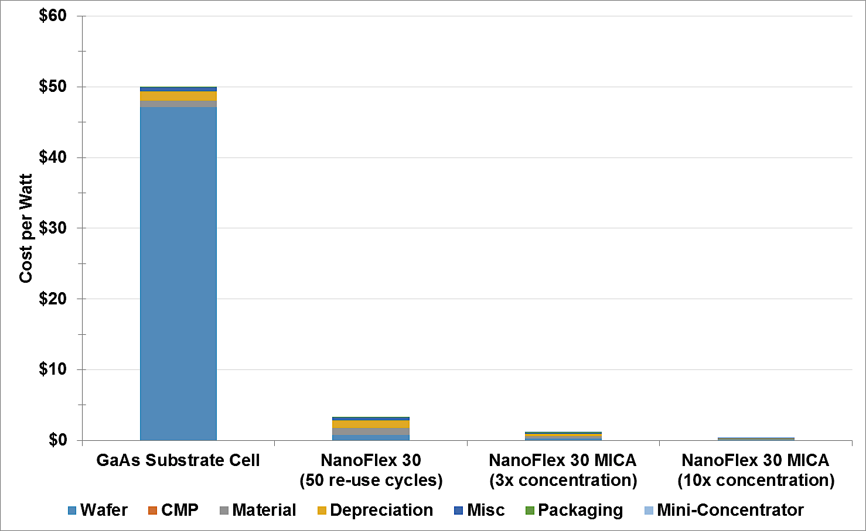
Wafer Reuse & Mini-Concentrators
Break the Cost Curve for High Efficiency Solar Thin Films
~$50/W
1
2
3
ND-ELO reduces cost by
up to
90%
CPC integration cuts cell size & cost
Higher concentration drives cost below current silicon-based panels
$3.31/W
$1.17/W
$0.41/W
Notes: Preliminary directional pricing projections reflect estimated dual-junction III-V solar cell costs in the 2020 timeframe at production scale.
Source: Price projections from National Renewable Energy Laboratory, NanoFlex Power, University of Michigan.
Proprietary
7

Slide 8
NanoFlex Technology Evolution, Value Creation & Market Expansion
Next Generation
ND-ELO
10-15x ND-ELO
Ultra-High Efficiency Thin Films
2-3x ND-ELO
Integrated Mini-Concentrators
Integrated Low-Cost Solar Tracking
Step-change cost reduction for broader market entry
5
4
Further increases energy production density
3
Increases production density and reduces cost for solar farms & multi-story rooftop
2
Cost structure competitive in initial terrestrial markets
1
Dramatically reduces solar cell cost for space applications
Time
Value Creation
Proprietary
8

Slide 9
Sustainable Market Development Strategy from High Value to High Volume
A ROADMAP TO SUCCESS:
Initial focus on high value applications …
Enabled Applications
Low-cost, high efficiency flexible thin films enable new applications such as automotive & transportation, consumer electronics, wearables, remote sensors, etc.
Rooftop / BAPV
~15 GW, $10 billion
Low-cost, flexible high efficiency membranes for flat commercial
rooftops, multi-story rooftops, facades, curtain walls, etc.; augmentation for silicon PV
Solar Farms
~30 GW, $20 billion
Low-cost, high efficiency, lightweight panels with mini-concentrators and/or low cost integrated tracking for solar farm applications in high density areas
Portable Power
50-160 MW, $500-800M*
High efficiency, flexible
& lightweight solar
sheets & portable packs for military, emergency response, outdoor enthusiasts
Aerospace
…transition to larger markets & enabled applications
<1 MW, $300-400M
High efficiency lightweight solar arrays for space vehicles & unmanned aerial vehicles (UAVs)
Sources: Aerospace market data from Emcore SEC filings & Spectrolab media sources; *Field & Mobile reflect NanoFlex estimates of potential for specialty markets; BIPV estimates from BCC Research (c 2019); Solar Farm and Rooftop/BAPV volume estimates from SolarPower Europe, NanoFlex est. 1/2 of rooftop market is commercial; pricing assumptions from DOE Sunshot Targets
Proprietary
9

Slide 10
Example:
Portable Power Markets & Specialty Field Applications
Soldier Power Mission
Develop, acquire and field expeditionary, lightweight Soldier power solutions intended for the most austere operating environments and designed to reduce Soldier load and increase lethality.
Why NanoFlex is Better:
Highest power per area
Highest power per weight
Flexible
Lightweight
Rugged
Harvest diffuse light
High thermal tolerance
Cost competitive
Made in the USA
Lighten the Load & Bring Power Forward
One out of eight U.S. casualties during Operation Iraqi Freedom was sustained by a soldier protecting a fuel supply convoy. Cumulatively, over the past decade, more than 3,300 U.S. troops have died during attacks on fuel convoys.¹
U.S. military operations in Afghanistan have paid the equivalent of $400 per gallon of fossil fuel when security, transportation, and mortality costs are tallied up. The largest consumer of fuels on the battlefield is electricity generation.²
Notes: ¹ Solar Energies Industries Association & PV Magazine (May 2013) ; ² Navigant Consulting/Pike Research (4Q 2012); ⁻⁻ Claims based on preliminary specifications
Proprietary
10

Slide 11
Example:
Portable Power Markets & Specialty Field Applications
Ultra-high efficiency, lightweight, and flexible thin films deliver 2.4x more power in a 10% smaller footprint and less than half the folded volume
2.4x more power
10% smaller footprint
max power
surface area of solar sheet
23.3
4.3
240
Watts
Square Feet
14.4
12.9
2.5
100
100
1.5
NanoFlex 240W
Solar Sheet
PowerFilm 100W
Solar Sheet
Global Solar 100W
Solar Sheet
NanoFlex 240W
Solar Sheet
PowerFilm 100W
Solar Sheet
Global Solar 100W
Solar Sheet
NanoFlex Ultra-High Efficiency Flexible Solar Sheet vs. Competing Military Products
Notes: NanoFlex product estimates for 240W solar sheet by NanoFlex & GreenPath Technologies for production-level sheet assembly of NanoFlex solar cells & metrics; PowerFilm FM16-6000 100W solar sheet; Global Solar P3-100W 100W solar sheet
Proprietary
11

Slide 12
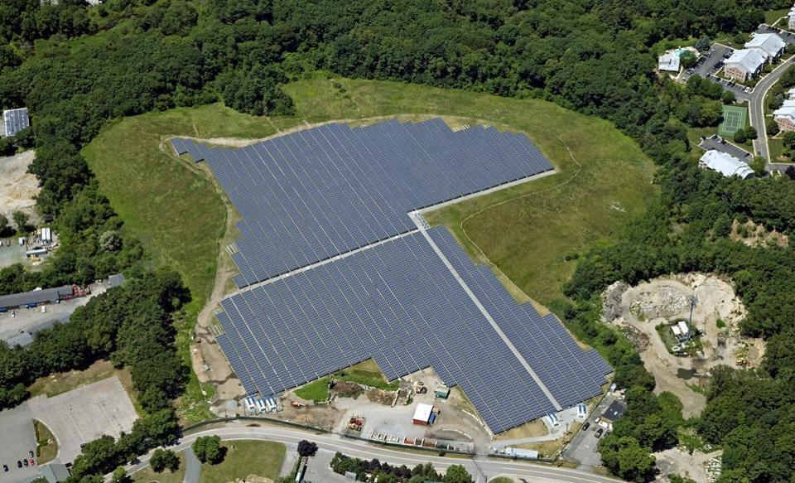
Example:
Solar Farms can make Sense in High Density Locations
Why NanoFlex is Better:
Increase energy density
Reduce real estate footprint
Reduce balance of systems
Harvest diffuse light
Optimize interconnection
Lightweight & rugged
High thermal tolerance
Cost competitive
Made in the USA
NanoFlex overcomes disadvantages in high density areas, including:
High real estate costs
High installation & balance of systems costs
Suboptimal lighting conditions
Notes: ¹ Claims based on preliminary specifications
Source: Southern Sky Renewable Energy, 5.6MW solar farm on 15.5 acres
Proprietary
12

Slide 13
Example:
Solar Farms can make Sense in High Density Locations
Ultra-high efficiency, lightweight panels outperform current best-in-class solutions, yielding substantial balance of system cost reductions
36% more power per panel
48% lighter weight
max power per 3’x5’ panel
weight per surface area
470
345
2.3
Watts
lb per sf
1.2
NanoFlex 30 MICA High Power Panel
SunPower
X-Series 345
NanoFlex 30 MICA High Power Panel
SunPower
X-Series 345
NanoFlex 30 MICA Ultra-High Efficiency Panels vs. Current Best-in-Class Panels
Notes: Estimates by NanoFlex & GreenPath Technologies for production-level assembly of NanoFlex solar cells & metrics reflect energy production density (kW-hr/m²) associated with integrated mini-concentrators; SunPower X-Series X21-345 Panel
Proprietary
13

Slide 14
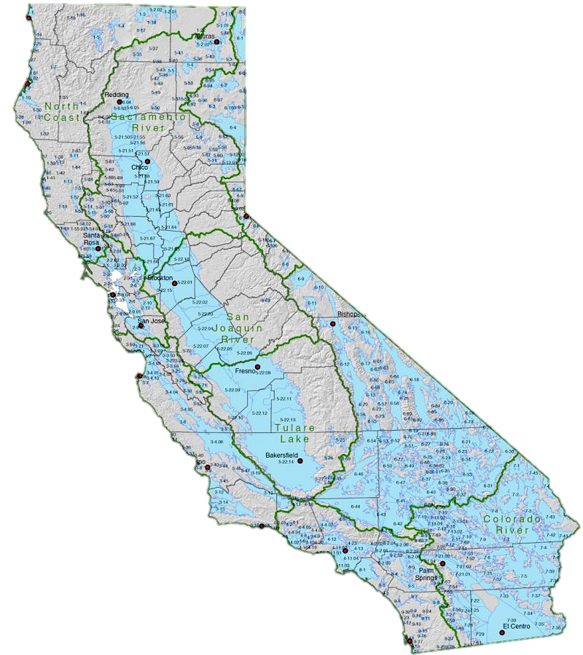
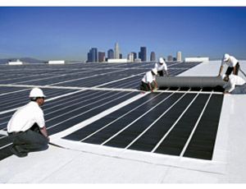
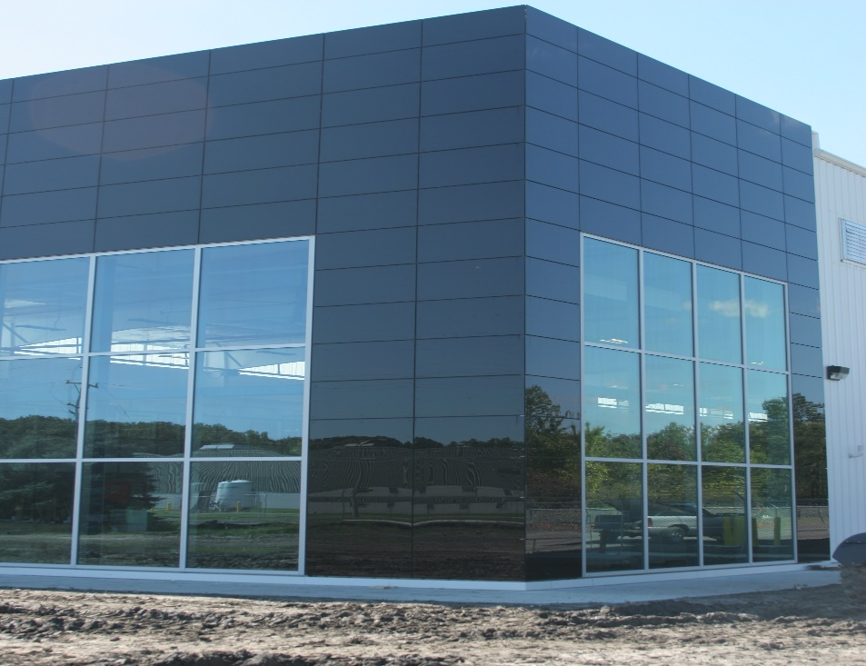
Example:
Enabling Net Zero Energy Buildings
Global BIPV installations expected to increase from 1.6 GW in 2014 to more than 2.6 GW in 2019
- BCC Research
Source (L to R): CoolFlatRoof.com; PV Curtain Wall by BISEM at Guardian Industries Science and Technology Center in Detroit, Michigan
Big Bold Goals – Adopted 2007-08
by Energy, Utilities Commissions
Source: California Public Utilities Commission
All new residential construction in California will be zero net energy by 2020
All new commercial construction in California will be zero net energy by 2030
50% of existing commercial buildings will be retrofit to ZNE by 2030
Proprietary
14

Slide 15
Example:
Enabling Net Zero Energy Buildings
Ultra-high efficiency, lightweight panels dramatically outperform
in multi-story rooftop and BAPV markets, enabling Net Zero Energy Buildings
2.3x more power per m²
2.3x more power per kg
power to surface area ratio
power to weight ratio
311
118
Watt / m2
Watt / m2
176
135
55
55
NanoFlex 30 MICA High Power Panel
CIGS Solar Module
Monocrystalline Lightweight Solar Panel
NanoFlex 30 MICA High Power Panel
CIGS Solar Module
Monocrystalline Lightweight Solar Panel
NanoFlex 30 MICA Ultra-High Efficiency Panels vs. Competing Lightweight Solar Products
Notes: Estimates by NanoFlex & GreenPath Technologies for production-level assembly of NanoFlex solar cells & metrics reflect energy production density (kW-hr/m²) associated with integrated mini-concentrators; CIGS from MiaSole FLEX-01W specifications; Monocrystalline from Renogy RNG-100DB specification (100W)
Proprietary
15

Slide 16
Commercialization & Monetization Roadmap
Capital-efficient business model based on joint development, licensing, and product sales via fabless manufacturing with major industry partners
Invention
Product Development
Prototypes & Demos
License
Fabless Production
Research Labs
NanoFlex Engineering
Manufacturing Fabs
$
$
Monetize Technology
Through
4
3
2
4
1
Revenue Sources
Proprietary
Government Grants & Sponsored R&D
Development Revenue
Licensing Royalties
Product Sales
16

Slide 17
Exclusive Worldwide Rights to Key Patents
Exclusive rights to an extensive portfolio of issued/pending patents covering all aspects of our breakthrough technologies
Materials
Architectures
Processes
Materials made from common elements at very low costs that assemble into desired structures
Proprietary device architectures utilize material-specific characteristics to enable high power output and long life
Proprietary processes for ultra-low-cost fabrication of high-performance materials and architectures
Fullerene acceptors
Blocking layers
New materials for visible & infrared sensitivity
Protective & sacrificial layering of III-V solar cell growth
Mini-compound parabolic arrays
Integrated tracking with Kirigami
Monolithically integrated micro-inverters
Multi-junction organic solar cell
Mixed layer & nanocrystalline cells
Transparent/semi- transparent cells
High speed non-destructive epitaxial lift-off
Cold weld bonding
Roll-to-roll mini- concentrator array processing
Scalable growth technologies
Proprietary
17

Slide 18
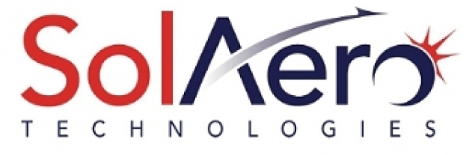
License Agreement Signed with
High Performance PV Leader, SolAero Technologies
Validates NanoFlex’s technology & begins commercialization of cost-competitive high efficiency thin films new, growing markets.
SolAero is a world leader in III-V solar cells, powering >170 space missions
Joint Development focused on commercializing NanoFlex’s cost-reduction technology
SolAero engineers implementing NanoFlex technology in their manufacturing process & in production-configuration solar cells
Signed license agreement for space and near-space applications
SolAero supplying NanoFlex with cells for customer demos & new market development
NanoFlex & SolAero commercialization of low-cost GaAs thin films for terrestrial applications like mobile power, solar farms, and rooftop/BAPV
Proprietary
18

Slide 19
The NanoFlex Team
Management Team
Dean L. Ledger | Co-Founder, CEO, Director | 35 years experience financing & developing technology opportunities; prev Director & EVP at Universal Display Corporation (Nasdaq: OLED)
J. Norman Allen | Chief Technology Officer | 35 years in battery, semiconductor, green energy ventures; prev President of New Products & Tech at Duracell; Founder/CEO of PowerSmart Electronics; Founder/COO of Ultracell; Founder/CEO of Solidia Technologies; Greentech Advisor at Kleiner Perkins; Operating Partner at Potomac Energy Fund
Ron DaVella | Chief Financial Officer, Director | 37 years experience as CFO, Board Member, and public accountant; Board Member at The Joint Corp. (Nasdaq: JYNT); prev CFO at Amazing Lash Studio; retired Audit Partner with Deloitte & Touche
Research Team
Dr. Stephen R. Forrest | University of Michigan | Professor of Electrical Engineering, Materials Science & Engineering, & Physics; track record of delivering commercially successful companies; Director at Applied Materials (Nasdaq: AMAT)
Dr. Mark E. Thompson | University of Southern California | Professor of Chemistry, Chemical Engineering, & Materials Science; instrumental in discovery & development of OLED technology
Proprietary
19

Slide 20
Key Milestones and Activities
Expand engineering team to support technology transfer
Receive sponsored funding to advance commercialization efforts through prototype development, testing, and manufacturing readiness
Fabricate prototypes and conduct demonstration projects
Advance process/technology to higher efficiency product configurations
Sign license agreement and supply agreement with SolAero Technologies
Reduce costs and adhere to strict spending discipline with a focus on supporting commercialization and revenue generation
Initiate professional marketing campaign and accelerate business development efforts
Proprietary
20

Slide 21
Investment Highlights
Solar power has only scratched the surface of its total opportunity
NanoFlex-enabled solutions can dramatically outperform current thin films, enabling new applications & unlocking markets
Initially targeting military & portable power applications, followed by high density solar farms and multi-story/space-constrained rooftops
Commercialization of NanoFlex’s cost reduction technologies ongoing via joint development with manufacturing partner SolAero Technologies
Currently pursuing multiple sponsored development projects to accelerate commercialization & generate near-term revenue
Capital efficient business model via fab-less manufacturing & licensing with industry partners accelerates commercialization & mitigates risk
Proprietary
21

Slide 22
THANK YOU
Dean L. Ledger
Chief Executive Officer
(480) 585-4200
dledger@nanoflexpower.com
Ron DaVella
Chief Financial Officer
(480) 585-4200
rdavella@nanoflexpower.com
Proprietary
22

